Slide 1
Expanding Your Horizon

Slide 2
Perspective of a “Non-Engineer”

Slide 3
PROJECT MANAGER
CONS
Subject Matter Expert in only one field
Not familiar with the process
Ask a lot of questions
PROS
Subject Matter Expert in one field
Task driven process
Ask a lot of questions

Slide 4
CHALLENGES

Slide 5
PROJECT MANAGER Scope/Schedule/Budget
Organized
Humility
Independent
Multi-tasker
Excellent Communicator
Motivated
Decision Maker
Confidence
…… and sometimes Magical

Slide 6
PROJECT MANAGER Scope/Schedule/Budget
Organized
Humility
Independent
Multi-tasker
Excellent Communicator
Motivated
Decision Maker
Confidence
…… and sometimes Magical

Slide 7
Don’t just think outside the box, get rid of the box!

Slide 8
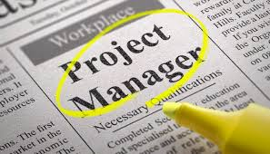
ENDLESS POSSIBILITIES
Right of Way Agents
Designers
Planning Staff
Surveyors
Environmental Coordinators
Utility Technicians

Slide 9
OPPORTUNITY TO SUCCEED

